Slide 1
High School Counselors’ Association of WNY Stephanie Swim

Slide 2
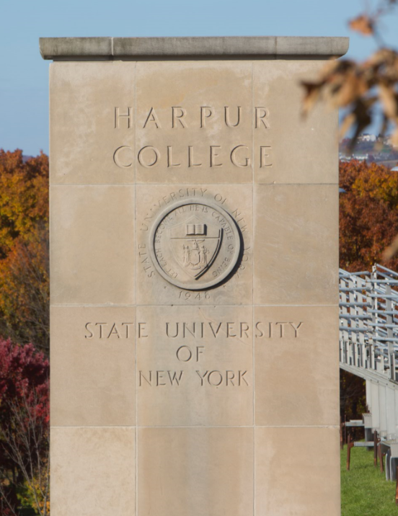
Liberal Arts at Binghamton University
Binghamton General Education Requirements
Language and Communication
Creating a Global Vision
Liberal Arts
Aesthetics
Humanities
Laboratory Sciences
Social Sciences
Mathematics
Bridge to Professional Programs

Slide 3
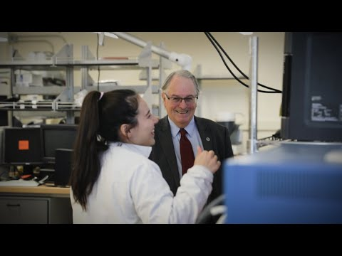
Why Harpur College?
From breadth through depth to perspective
Provides a broad base of knowledge as well as writing, speaking and critical thinking skills
In-depth understanding of content and problem-solving skills in an area of specialization
Able to adapt and evolve with the changing world

Slide 4
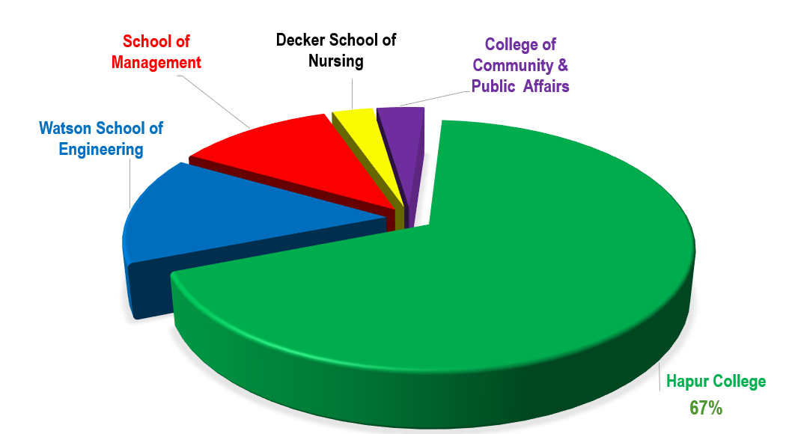
Undergraduate Students Binghamton University
Notes:
With about 14,000 UG students at BU, Harpur UG students make up 67% of UG population @ BU

Slide 5
Harpur College of Arts and Sciences
Over 40 majors: 3 DIVISIONS, 26 DEPARTMENTS, 14 PROGRAMS
Fine Arts and Humanities
Science and Mathematics
Interdisciplinary and Cross-Disciplinary Programs
Africana Studies
Art and Design
Art History
Asian and Asian-American Studies
Cinema
Classical and Near Eastern Studies
Comparative Literature
English, General Literature, and Rhetoric
German and Russian Studies
Judaic Studies
Music
Philosophy
Romance Languages and Literatures
Theatre
Biological Sciences
Chemistry
Geological Sciences and Environmental Studies
Mathematical Sciences
Physics, Applied Physics and Astronomy
Psychology
Biochemistry
Environmental Studies
Human Rights
Individualized Major Program
Integrative Neuroscience
Latin American and Caribbean Area Studies
Linguistics
Materials Science and Engineering
Medieval and Renaissance Studies
Middle East and North African Studies
Philosophy, Politics, and Law
Religious Studies
Russian and East European Studies
Translation Research and Instruction
Women, Gender and Sexuality Studies
Social Sciences
Anthropology
Economics
Geography
History
Political Science
Sociology

Slide 6
Our 10 most popular majors
Biology
Economics
Psychology
Integrative Neuroscience
Mathematical Sciences
Philosophy, Politics & Law
English
Political Science
Environmental Studies
Biochemistry
All majors & programs can be found here: http://binghamton.edu/harpur/undergraduate/index.html

Slide 7
BU’s Pharmacy Early Acceptance Program (PEAP)
Eligibility & Requirements
PEAP Process
Routes
2+4 pathway (only PharmD)
3+4 pathway
4+4 pathway
New State of the Art School of
Pharmacy & Pharmaceutical Sciences
Facility
More on PEAP here:
https://www.binghamton.edu/pharmacy-and-pharmaceutical-sciences/students/future/peap.html

Slide 8
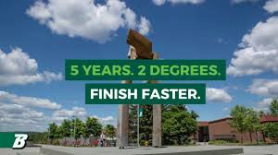
Accelerated 4+1 Programs
Earn Bachelor’s & Master’s Degree in 5 years
50+ Programs
All Harpur UG + MBA
All Watson UG + MBA
Accelerated/4+1 Degree Programs - The Graduate School

